Slide 1

Mental Fitness Tracker using Machine Learning
NAME : JAYESH RAJ
COLLEGE NAME : C. V. RAMAN GLOBAL UNIVERSITY, BHUBANESWAR
COLLEGE STATE : ODISHA
SKILLSBUILD MAIL ID : rajjayesh916@gmail.com
INTERNSHIP DOMAIN : ARTIFICIAL INTELLIGENCE
DURATION OF INTERNSHIP : 12/06/2023 – 24/07/2023

Slide 2
PROJECT TITLE/PROBLEM STATEMENT
Mental Fitness Tracker using Machine learning
Machine learning algorithms can be trained on large datasets of mental health data to identify patterns and make predictions about an individual's mental fitness. By analyzing factors such as sleep patterns, social media activity, and exercise habits, these algorithms can provide insights into an individual's mental state that may not be immediately apparent to them or their healthcare provider.
One example of how machine learning is being used to track mental fitness is through the development of mobile apps that use sensors in smartphones to monitor physical activity, sleep, and other behaviors associated with mental health. These apps can then use machine learning algorithms to analyze this data and provide personalized recommendations for improving mental fitness, such as suggesting meditation exercises or recommending changes to sleep habits.

Slide 3
AGENDA
Welcome, everyone! Today, we're going to talk about something that affects all of us: mental fitness. It's a topic that's often overlooked, but one that's incredibly important. After all, just like we need to take care of our physical health, we also need to take care of our mental health.
What is Mental Fitness? Mental fitness refers to the ability to cope with life's challenges and maintain a positive outlook. It involves being able to regulate your emotions, manage stress, and maintain healthy relationships.
Why is mental fitness important? Just like physical fitness, mental fitness is essential for overall well-being. It can help you perform better at work or school, improve your relationships, and enhance your overall quality of life.
But how do we track our mental fitness? That's where machine learning comes in. By using advanced algorithms and data analysis, we can gain insights into our own mental well-being and make positive changes in our lives. So, let's dive in and explore this exciting new field!

Slide 4
PROJECT OVERVIEW
The Mental Fitness Tracker is a cutting-edge tool designed to help users monitor their mental well-being. By integrating advanced machine learning algorithms, the model can identify patterns and provide insights that can help users better understand their mental health.
Algorithmic Insights
The model uses advanced machine learning algorithms to identify patterns and provide insights for users.
Real-Time Tracking
The model provides real-time tracking of mental well-being, allowing users to monitor their progress and make adjustments as needed.
Personalized Details
Based on the user's data, the model can provide personalized details for improving mental well-being.

Slide 5
WHO ARE THE END USERS OF THIS PROJECT?
The end users would typically be individuals who are seeking to improve and monitor their mental well-being. This could include people of all ages and backgrounds who are interested in maintaining a healthy mind and managing their emotional states.
The end users might include:
General Users: These are individuals who are interested in monitoring their mental fitness and well-being on a regular basis. They may use the mental fitness tracker to track their moods, set goals, and receive personalized recommendations for improving their mental health.
Mental Health Professionals: Mental health professionals such as therapists, psychologists, and counselors may use the mental fitness tracker to gain insights into their clients' mental well-being. It can help them track progress, identify patterns, and provide more targeted support and interventions.
Corporate and Workplace Users: Many organizations are recognizing the importance of mental health in the workplace. Employees may use the mental fitness tracker to monitor their stress levels, set boundaries, and practice self-care. Employers can also leverage the data from the tracker to identify trends and implement strategies to support their employees' mental well-being.
Researchers and Academics: Researchers and academics in the field of mental health may use the data collected by the mental fitness tracker to analyze trends, conduct studies, and gain insights into various aspects of mental well-being. This data can contribute to the development of new interventions and approaches for mental health support.

Slide 6
YOUR SOLUTION AND ITS VALUE PROPOSITION
our solution aims to provide a comprehensive and user-friendly platform that helps individuals improve their mental well-being. Here are the key requirements and the value proposition of our solution.
Goal Setting and Progress Tracking: Our solution will enable users to set personalized mental health goals and track their progress over time. This feature encourages users to establish achievable targets and provides them with a sense of accomplishment as they make progress towards their goals.
Value Proposition: By offering goal setting and progress tracking capabilities, our mental fitness tracker fosters motivation and accountability. Users can celebrate their achievements and stay motivated to continue their mental fitness journey, leading to a greater sense of satisfaction and well-being.
Personalized Recommendations: The mental fitness tracker will analyze user data and provide personalized recommendations and strategies for improving mental health. These recommendations could include mindfulness exercises, stress management techniques, self-care practices, and other evidence-based interventions.
Value Proposition: By delivering tailored recommendations, our solution ensures that users receive targeted and practical guidance for enhancing their mental well-being. This personalized approach increases the effectiveness of the tracker in supporting users' mental fitness goals.

Slide 7
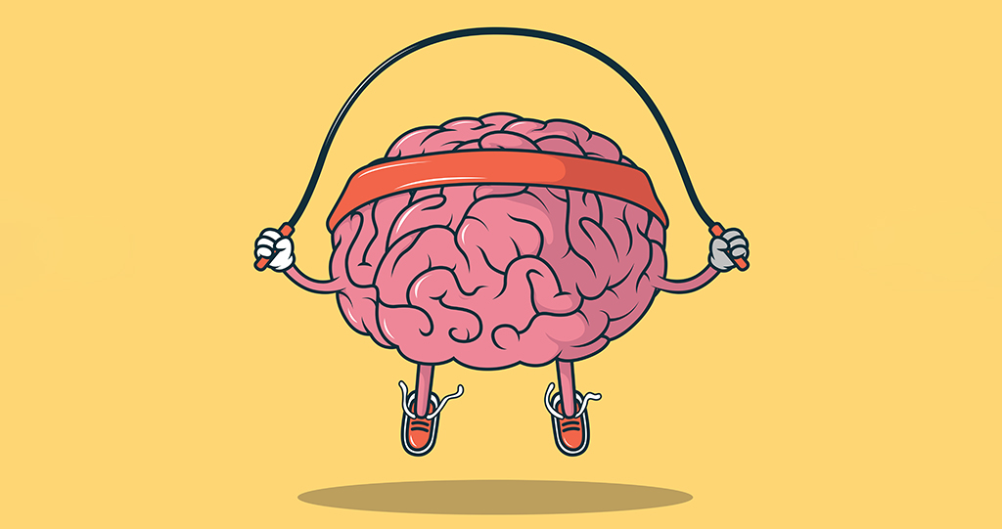
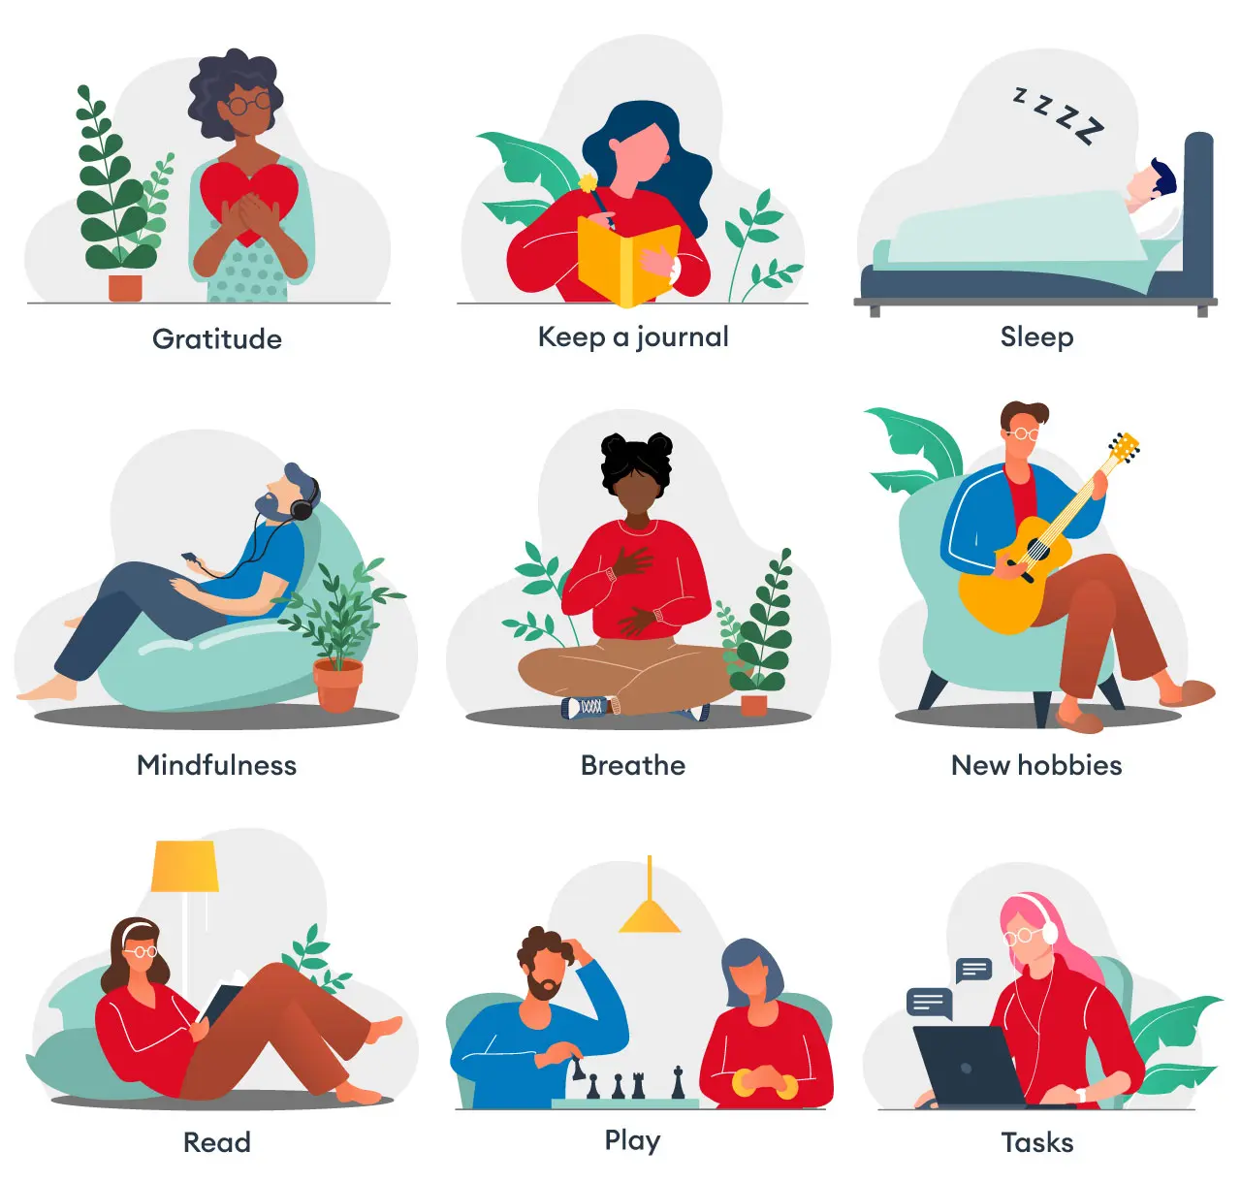

HOW DID YOU CUSTOMIZE THE PROJECT AND MAKE IT YOUR OWN
To customize this project and make it our own, we started by conducting extensive research on the latest trends and innovations in machine learning modelling for mental fitness tracking. I also read articles of experts in the field to gain insights into best practices and potential challenges.
Using the knowledge and resources gathered, a unique approach is developed to machine learning modelling that incorporated advanced algorithms and data analysis techniques. I also focused on creating a user-friendly interface that would make it easy for individuals of all ages and backgrounds to track their mental fitness and improve their overall well-being.
We can also help people by recommending some yoga and exercises for people who have issues related to their mental fitness after viewing the results form the mental fitness tracker.

Slide 8

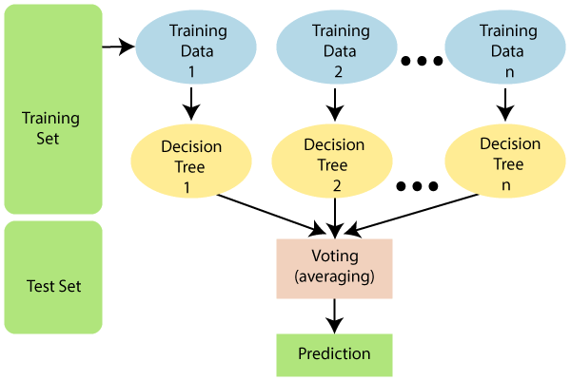
MODELLING
In this project we have mainly used two different algorithms:
Linear Regression – It is a statistical technique used to model the relationship between a dependent variable and one or more independent variables. It assumes a linear relationship between the variables and aims to find the best – fitting straight line that minimizes the overall distance between the observed data points and the predicted values.
Random forest regression – It is a machine learning algorithm that combines multiple decision tree models to make prediction . It works by constructing an ensemble of decision tree and aggregating their predictions to obtain a more accurate and robust result. Each decision tree is trained on a different subset of the data and a random subset of features.

Slide 9
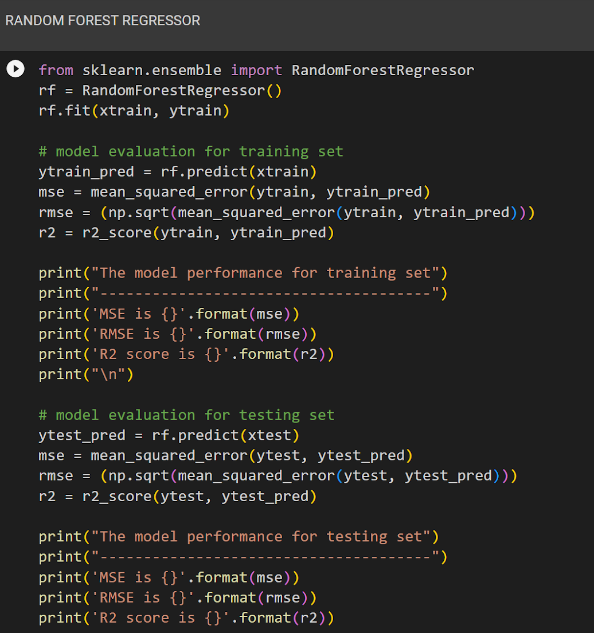
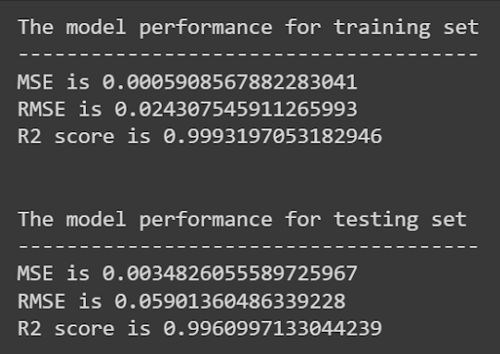
RESULTS

Slide 10
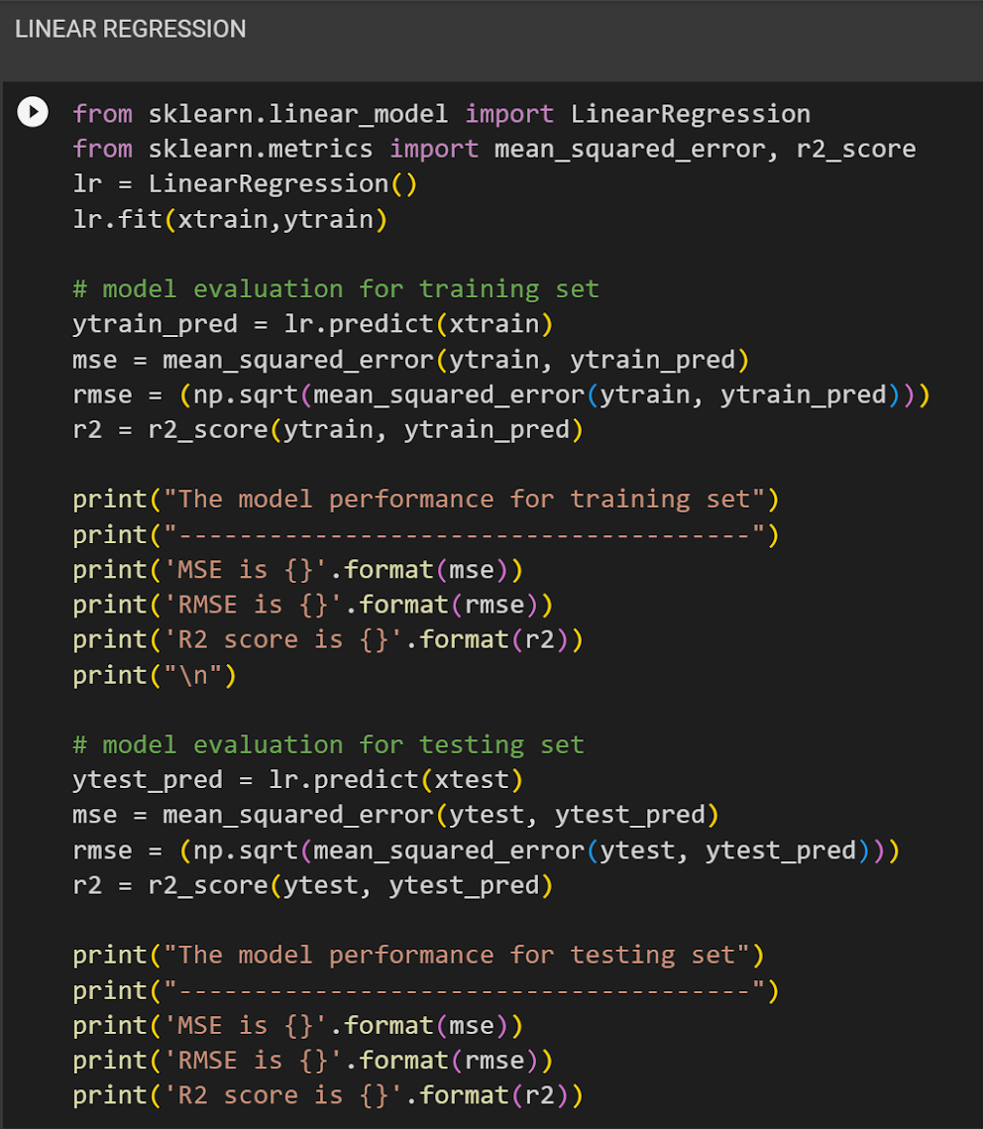
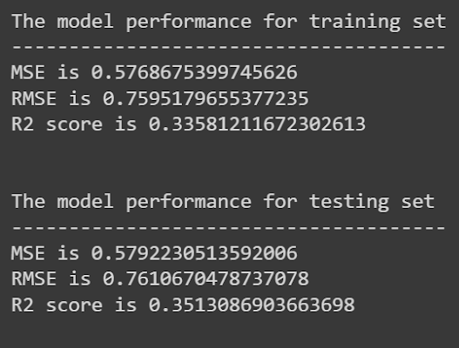

Slide 11
LINKS
I’m pleased to provide you with a comprehensive list of materials used in the project, along with their corresponding links for reference. These materials have been carefully selected to ensure the successful completion of our project goals. Please find the details below:
Research paper link :
https://www.hindawi.com/journals/acisc/2022/9970363/ Volume 2022 | Article ID 9970363 | https://doi.org/10.1155/2022/9970363
Dataset link :
https://drive.google.com/file/d/1yqscvSf4NJBCHjzWWYmFmSIE5sDUnql5/view?usp=sharing https://drive.google.com/file/d/1ki-TIfyEK6JZcoNuMxmgESavMpvsELjv/view?usp=sharing
Google Colab link :
https://drive.google.com/file/d/1FFoE6E9tF-Kk9G7TLwb79a1Jcl0F0F55/view?usp=sharing
I recommend reviewing the provided links to gain a better understanding of the materials used in our project. These links will provide you with relevant information, specifications, and any additional details related to each material.

